Slide 1
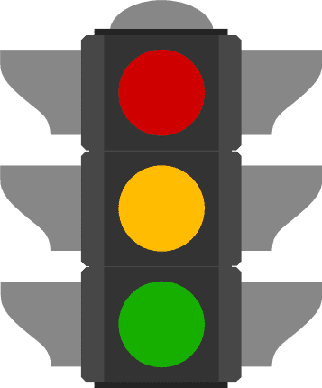
Traffic Lights
GREEN — Keep going! YELLOW — Proceed Slowly RED — Stop!

Slide 2
Stacks & Queues
TIP102
Week 3
Notes:
🌟 Purpose: To set the tone for the session and introduce the topic of Stacks & Queues.
✅ What should I be doing?
Greet students warmly and encourage them to turn on their cameras for better engagement.
🎙️ What should I be saying?
Welcome to Week 3 of TIP102! Today, we’ll be diving into two key data structures: Stacks and Queues. These structures are foundational tools for solving many algorithmic problems.

Slide 3
1 | Welcome 👋🏽 | 0:00 - 0:10
2 | Stacks & Queues | 0:10 - 0:45
3 | BREAK | 0:45 - 0:50
4 | Collaborative Problem Solving | 0:50 - 1:50
5 | Wrap Up | 1:50 - 2:00
Notes:
🌟 Purpose: To provide a roadmap for the session and set expectations for timing and topics.
✅ What should I be doing?
Walk students through the agenda.
Highlight key moments, such as the break and collaborative problem-solving session.
🎙️ What should I be saying?
Here’s what today looks like. We’ll begin with an introduction to Stacks and Queues, taking time to discuss their use cases and how they work.
After a short break, we’ll move into breakout rooms for collaborative problem solving.
To wrap up, we’ll share one good thing from today’s session and complete our session survey. Let’s make the most of our time together!
🙌🏽 How should I engage students?
Ask students if they have any questions or concerns about the agenda.
Emphasize the collaborative nature of the problem-solving session and encourage them to stay active and engaged throughout.

Slide 4
Welcome! 👋🏽
10 minutes

Slide 5


Turn on your cameras
Fill out the entry ticket
Notes:
🌟 Purpose: Encourage visual engagement to foster connection during the session.
✅ What should I be doing?
Prompt students to enable their cameras and submit the entry ticket.
🎙️ What should I be saying?
Let’s kick off our session by turning on our cameras!
Also, don’t forget to fill out the entry ticket to help us organize breakout rooms later.
🙌🏽 How should I engage students?
Use humor or compliments: "Let’s see those smiles!"
Acknowledge and thank students who turn on their cameras.

Slide 6

Turn on your cameras
Fill out the entry ticket
Notes:
🌟 Purpose: Encourage visual engagement to foster connection during the session.
✅ What should I be doing?
Prompt students to enable their cameras and submit the entry ticket.
🎙️ What should I be saying?
Let’s kick off our session by turning on our cameras!
Also, don’t forget to fill out the entry ticket to help us organize breakout rooms later.
🙌🏽 How should I engage students?
Use humor or compliments: "Let’s see those smiles!"
Acknowledge and thank students who turn on their cameras.

Slide 7
“Shoutout to myself today”
Polls
“Seeing how others would solve problems I struggle with”
- go over questions from breakout session
- need tougher questions in lecture
- problem set not related to lecture
Notes:
🌟 Purpose: Share feedback from the previous session and highlight areas of success and improvement.
✅ What should I be doing?
Summarize feedback from the previous session's survey and present key takeaways.
🎙️ What should I be saying?
From your feedback, it seems many of you enjoyed [highlighted aspect]. One suggestion was [area for improvement]. We’ll work on that today.
🙌🏽 How should I engage students?
Ask: "Does anyone have additional feedback or suggestions?"

Slide 8

Announcements + Reminders
Please make sure you’re in full view when your camera’s on
There will be class on Juneteenth this Thursday
Introducing Buddy Breakouts!
Opportunity to work with the same group of students week after week
Must fill out Buddy Breakout Creation Form no later than 9 AM PT/12 PM ET the day of class
All members must agree to be in the buddy breakout!
You can opt out of your group by reaching out to support@codepath.org
Next Week: The first session will be the Career Workshop (C3) hosted by the Career Center!
This is mandatory!
More info to come!
Loom Recording of Announcements!

Slide 9
Stacks & Queues
35 minutes

Slide 10
3 minutes
What do we know about stacks and queues?
Notes:
🌟 Purpose: To engage students in recalling prior knowledge about stacks and queues and to introduce the topic in an interactive way.
✅ What should I be doing?
Pose the discussion question to the class and encourage participation through the chat or unmuting.
Facilitate the discussion by prompting students with examples if needed.
Make notes of key terms or misconceptions for clarification in the next slides.
🎙️ What should I be saying?
Before we dive into stacks and queues in detail, let’s take a moment to think about what we already know. What comes to mind when you hear the terms 'stack' or 'queue'? How do you think they might be used in programming? Feel free to share in the chat or unmute to share your thoughts!
After a few responses: Great! It seems like we have some ideas already. Let’s build on these as we go through today’s session.
🙌🏽 How should I engage students?
Acknowledge and validate all responses: "That’s an interesting point!" or "Yes, that’s a great example!"
If students are hesitant, provide hints or relatable examples, such as "A stack could be like a stack of books, and a queue could be like a line at the grocery store."
If there’s a misconception, address it with an example: "That’s a good observation, but let’s think about whether a queue might allow us to access the middle element easily."
Encourage quieter students by asking, "Anyone else have examples or thoughts to share?"

Slide 11
Stacks
LIFO (Last In, First Out) data structure.
Use cases: Backtracking, reversing data, expression evaluation.
Implementation: Stacks are implemented using Python’s list and the append() and pop() methods.
Notes:
🌟 Purpose: To explain the fundamental concepts of stacks, their use cases, and how they are implemented in Python.
✅ What should I be doing?
Explain the LIFO (Last In, First Out) concept using relatable examples.
Walk through the provided use cases to demonstrate practical applications of stacks.
Briefly describe the implementation in Python with examples of append() and pop() methods.
🎙️ What should I be saying?
"Stacks are a data structure that follow the Last In, First Out principle, meaning the last element added to the stack is the first one to be removed. A good analogy is a stack of plates—you always remove the top plate first.
Now let’s talk about some common use cases. Stacks are perfect for scenarios like backtracking, such as undoing operations in an editor, reversing data like strings or arrays, or evaluating mathematical expressions.
In Python, we implement stacks using lists. The append() method is used to add an element to the stack, and pop() removes the topmost element. We’ll see how this works in code shortly.
🙌🏽 How should I engage students?
Ask: "Can anyone think of an example where you might have used a stack, even outside of programming?"
After explaining the Python implementation:
Show a quick code example, like: stack = []
stack.append(10)
stack.append(20)
print(stack.pop()) # Output: 20
Pause and ask: "What do you think will happen if we call pop() again?"
Encourage questions: "Does this make sense? Would you like me to explain any part again?"

Slide 12
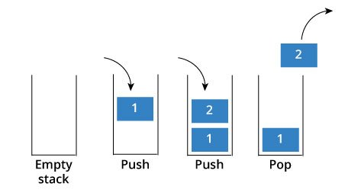
Stacks
LIFO: Last in - first out
my_stack = []
Operations
append(x): add to stack
pop(): remove from stack
Notes:
Explain difference between pop / peek

Slide 13
Stacks: Metaphor
Plates
CD Disc
Chairs
Blankets

Slide 14
Stacks: Practical Application
Reversing data
Balancing symbols - we will see this in demo
Backtracking (DFS - depth first search)
Save the current step to be revisited
Equation evaluation (2x4+1)
=> sometimes more than 1 stack will be used

Slide 15
Stack Questions
Determine if parentheses are valid
Reverse items in a list
Find the 3rd largest value in a stream of data
Notes:
🌟 Purpose: To introduce the concept of queues, explain their use cases, and demonstrate their implementation in Python using the deque class.
✅ What should I be doing?
Explain the FIFO (First In, First Out) principle with a relatable example.
Discuss the use cases for queues in practical applications like task scheduling and breadth-first search (BFS).
Provide a brief overview of how Python's deque class is used to implement queues.
🎙️ What should I be saying?
Queues are a data structure that operate on a First In, First Out principle, meaning the first element added is the first one to be removed. Think about a line at a movie theater—the first person in line is the first to get their ticket.
Queues are commonly used in task scheduling, where jobs need to be processed in the order they are received, and in algorithms like breadth-first search, where we explore nodes level by level.
In Python, we use the deque class from the collections module to implement queues because it is optimized for adding and removing elements from both ends efficiently. Let’s look at a simple example in Python.
🙌🏽 How should I engage students?
Ask: "Can anyone think of other scenarios where a queue might be useful, either in programming or in real life?"
Provide a quick Python example: from collections import deque
queue = deque()
queue.append(1) # Enqueue
queue.append(2)
print(queue.popleft()) # Dequeue: Output 1
After showing the code, ask: "What do you think will happen if we print the queue now? Why?"
Encourage questions and discussion about the differences between stacks and queues: "What makes queues different from stacks, and why would we use one over the other?"

Slide 16
Traffic Lights
GREEN — Keep going! YELLOW — Proceed Slowly RED — Stop!

Slide 17
Queues
FIFO (First In, First Out) data structure.
Use cases: Task scheduling, breadth-first search (BFS).
Implementation: Queues are implemented using Python’s deque class from the collections module.
Notes:
🌟 Purpose: To introduce the concept of queues, explain their use cases, and demonstrate their implementation in Python using the deque class.
✅ What should I be doing?
Explain the FIFO (First In, First Out) principle with a relatable example.
Discuss the use cases for queues in practical applications like task scheduling and breadth-first search (BFS).
Provide a brief overview of how Python's deque class is used to implement queues.
🎙️ What should I be saying?
Queues are a data structure that operate on a First In, First Out principle, meaning the first element added is the first one to be removed. Think about a line at a movie theater—the first person in line is the first to get their ticket.
Queues are commonly used in task scheduling, where jobs need to be processed in the order they are received, and in algorithms like breadth-first search, where we explore nodes level by level.
In Python, we use the deque class from the collections module to implement queues because it is optimized for adding and removing elements from both ends efficiently. Let’s look at a simple example in Python.
🙌🏽 How should I engage students?
Ask: "Can anyone think of other scenarios where a queue might be useful, either in programming or in real life?"
Provide a quick Python example: from collections import deque
queue = deque()
queue.append(1) # Enqueue
queue.append(2)
print(queue.popleft()) # Dequeue: Output 1
After showing the code, ask: "What do you think will happen if we print the queue now? Why?"
Encourage questions and discussion about the differences between stacks and queues: "What makes queues different from stacks, and why would we use one over the other?"

Slide 18
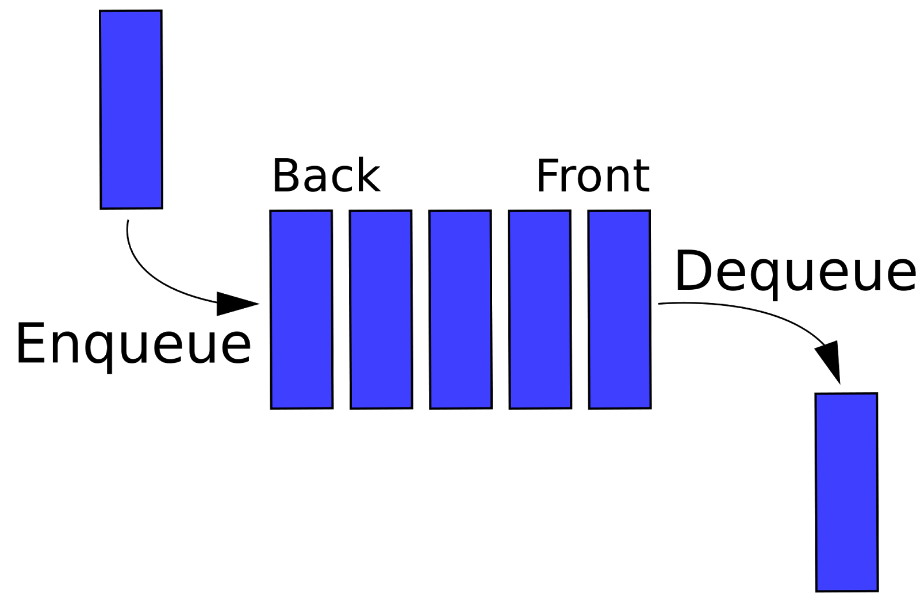
Queue
FIFO: First in - first out
my_queue = deque()
Operations
append(x): to enqueue
popleft(): to dequeue
Notes:
The deque is a class or custom data type that is part of the collections library in Python. A library is a collection of pre-written code that we can import into our own programs. Importing gives us access to use the classes, functions, etc. defined inside the library.
Create a new instance of the deque class by assigning a variable to deque followed by parentheses. If you are unfamiliar with object oriented programming (OOP), this just means we create a new queue.

Slide 19
Queue: Metaphor
Grocery Lines
Theme Park Rides
Restaurants

Slide 20
Queue: Practical Application
Processing items
Breadth first search (BFS)
Round robin scheduling
Notes:
🌟 Purpose: To introduce the concept of queues, explain their use cases, and demonstrate their implementation in Python using the deque class.
✅ What should I be doing?
Explain the FIFO (First In, First Out) principle with a relatable example.
Discuss the use cases for queues in practical applications like task scheduling and breadth-first search (BFS).
Provide a brief overview of how Python's deque class is used to implement queues.
🎙️ What should I be saying?
Queues are a data structure that operate on a First In, First Out principle, meaning the first element added is the first one to be removed. Think about a line at a movie theater—the first person in line is the first to get their ticket.
Queues are commonly used in task scheduling, where jobs need to be processed in the order they are received, and in algorithms like breadth-first search, where we explore nodes level by level.
In Python, we use the deque class from the collections module to implement queues because it is optimized for adding and removing elements from both ends efficiently. Let’s look at a simple example in Python.
🙌🏽 How should I engage students?
Ask: "Can anyone think of other scenarios where a queue might be useful, either in programming or in real life?"
Provide a quick Python example: from collections import deque
queue = deque()
queue.append(1) # Enqueue
queue.append(2)
print(queue.popleft()) # Dequeue: Output 1
After showing the code, ask: "What do you think will happen if we print the queue now? Why?"
Encourage questions and discussion about the differences between stacks and queues: "What makes queues different from stacks, and why would we use one over the other?"

Slide 21
Queue Questions
Level order of a binary tree
Number of recent calls within a timeframe
Notes:
🌟 Purpose: To introduce the concept of queues, explain their use cases, and demonstrate their implementation in Python using the deque class.
✅ What should I be doing?
Explain the FIFO (First In, First Out) principle with a relatable example.
Discuss the use cases for queues in practical applications like task scheduling and breadth-first search (BFS).
Provide a brief overview of how Python's deque class is used to implement queues.
🎙️ What should I be saying?
Queues are a data structure that operate on a First In, First Out principle, meaning the first element added is the first one to be removed. Think about a line at a movie theater—the first person in line is the first to get their ticket.
Queues are commonly used in task scheduling, where jobs need to be processed in the order they are received, and in algorithms like breadth-first search, where we explore nodes level by level.
In Python, we use the deque class from the collections module to implement queues because it is optimized for adding and removing elements from both ends efficiently. Let’s look at a simple example in Python.
🙌🏽 How should I engage students?
Ask: "Can anyone think of other scenarios where a queue might be useful, either in programming or in real life?"
Provide a quick Python example: from collections import deque
queue = deque()
queue.append(1) # Enqueue
queue.append(2)
print(queue.popleft()) # Dequeue: Output 1
After showing the code, ask: "What do you think will happen if we print the queue now? Why?"
Encourage questions and discussion about the differences between stacks and queues: "What makes queues different from stacks, and why would we use one over the other?"

Slide 22
Traffic Lights
GREEN — Keep going! YELLOW — Proceed Slowly RED — Stop!

Slide 23
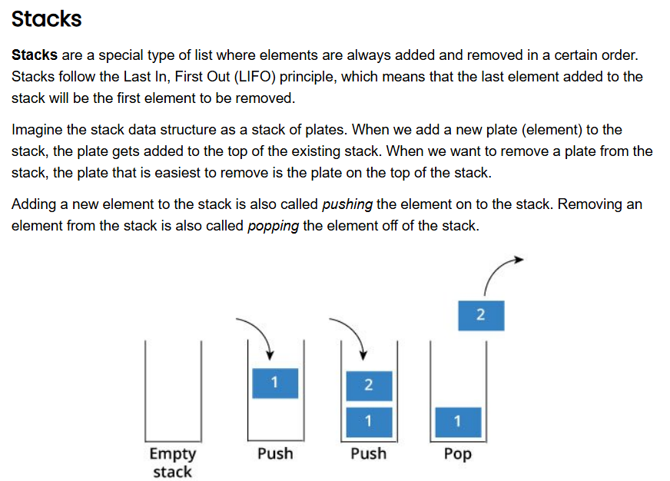
5 minutes
Open the Unit 3 Cheat Sheet and find Stacks.
What do you notice?
What do you wonder?
Notes:
🌟 Purpose: To guide students in understanding the fundamental characteristics of stacks by using the cheat sheet as a resource and encouraging them to observe and ask questions.
✅ What should I be doing?
Prompt students to open the Unit 3 Cheat Sheet and review the section on stacks.
Facilitate a discussion by asking students to share their observations and questions based on the cheat sheet.
Use follow-up questions to clarify concepts and address misconceptions.
🎙️ What should I be saying?
Take a moment to open the Unit 3 Cheat Sheet and find the section on stacks. As you read through the description and examples, think about what stands out to you. For example, why do you think we refer to this data structure as a stack?
Now, let’s reflect together:
What do you notice about how stacks operate?
What do you wonder? Are there any parts that seem unclear or spark your curiosity?
For instance, you might notice that stacks follow a 'Last In, First Out' principle. Can anyone think of a real-life analogy for this? For example, think about a stack of plates in a cafeteria.
🙌🏽 How should I engage students?
Encourage students to share their thoughts in the chat or by unmuting their microphones:
"What patterns or keywords jump out at you from the cheat sheet description?"
"What do you think the push and pop operations mean in this context?"
Provide clarifying explanations if needed. For example, if a student is confused about the LIFO concept, relate it back to the plate stack analogy.
Normalize any confusion by saying, "Great question! This is a tricky concept at first, but as we work through examples, it’ll make more sense."
Highlight key points from the cheat sheet, such as how stacks are often implemented using arrays or linked lists in programming.

Slide 24
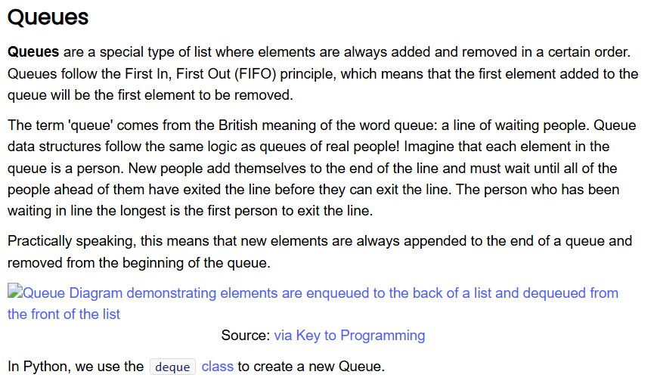
5 minutes
Open the Unit 3 Cheat Sheet and find Queues.
What do you notice?
What do you wonder?
Notes:
🌟 Purpose: To deepen students' understanding of queues by exploring their characteristics, use cases, and implementation details through the Unit 3 Cheat Sheet.
✅ What should I be doing?
Direct students to the Unit 3 Cheat Sheet and ask them to locate the section on queues.
Facilitate a conversation around their observations and questions about the material.
Provide explanations for any concepts that might seem unclear.
🎙️ What should I be saying?
Let’s take a moment to review the section on queues in the Unit 3 Cheat Sheet. As you read through it, consider the characteristics and examples provided. Think about how queues might differ from stacks or other data structures you know.
To guide our discussion, let’s answer these two questions:
What do you notice about queues?
What do you wonder about queues?
For example, you might notice that queues operate on a 'First In, First Out' (FIFO) principle. What are some real-world examples of this behavior? Perhaps a line at the grocery store? Let’s hear your thoughts!
🙌🏽 How should I engage students?
Encourage students to share their insights in the chat or out loud:
"What stands out to you about the enqueue and dequeue operations?"
"Why do you think the term 'queue' is used for this data structure?"
Address potential misconceptions, such as confusing queues with stacks, by emphasizing the FIFO vs. LIFO distinction.
Use interactive follow-ups:
"Can anyone think of a situation where a queue would be better than a stack? Why?"
"Why might we use the deque class in Python to implement a queue instead of a regular list?"

Slide 25
20 minutes
Write a function that checks if a given string containing parentheses is balanced. The function should return True if every opening parenthesis has a corresponding closing parenthesis in the correct order, and False otherwise.
Example Input:
"((()))"
"(()())"
"(()"
Example Output:
True
True
False
Notes:
🌟 Purpose: To demonstrate the Understand, Plan, and Implement steps of the UMPIRE strategy for solving the problem of checking balanced parentheses. Focus on clearly explaining the problem requirements, designing a solution, and beginning the implementation process.
✅ What should I be doing?
Walk through the Understand, Plan, and Implement steps:
Understand: Break down the problem and clarify the input/output.
Plan: Write out pseudocode for the solution using a stack.
Implement: Start coding the solution and test with one of the provided examples.
Engage students by asking questions and incorporating their feedback during planning and coding.
🎙️ What should I be saying?
Understand:
Let’s start by making sure we fully understand the problem. Our input is a string containing only parentheses, and our output is a boolean: True if the parentheses are balanced and in the correct order, False otherwise.
For example, if the input is "(())", it should return True, because every opening parenthesis has a corresponding closing one. But if the input is "(()", it should return False, because one opening parenthesis is missing its match.
Does anyone have questions about what the problem is asking us to do? [Pause for answers.]
Plan: "Now let’s plan our approach. We’ll use a stack because it’s a perfect tool for managing opening and closing parentheses. Here’s the step-by-step idea:
Initialize an empty stack.
Loop through each character in the string:
If it’s an opening parenthesis, push it onto the stack.
If it’s a closing parenthesis, check if the stack is empty:
If the stack is empty, return False.
Otherwise, pop the top of the stack.
After the loop, if the stack is empty, return True. If it’s not, return False.
This plan helps us ensure that every opening parenthesis has a corresponding closing one and that the order is correct. Does this make sense? What questions do you have about the plan?"
Implement:
Let’s start coding this step by step. I’ll begin by writing the loop to iterate through the string and handle opening parentheses. While I code, let’s think about how we’ll handle the closing parentheses check. [Pause to engage students.]
Does this first part make sense so far? Let’s test it with a basic input like "(())" and see if the stack behaves as we expect.
🙌🏽 How should I engage students?
Ask guiding questions during each step:
"What do you think happens if we don’t check if the stack is empty when we see a closing parenthesis?"
"Why is it important to check the stack after the loop ends?"
Encourage predictions: Before running the code, ask students what they expect the output will be for a given test case.
Normalize mistakes: Introduce a small mistake, such as forgetting to check the stack at the end of the loop, and debug it together.
"Hmm, this isn’t working as expected. Does anyone see what I missed?"

Slide 26
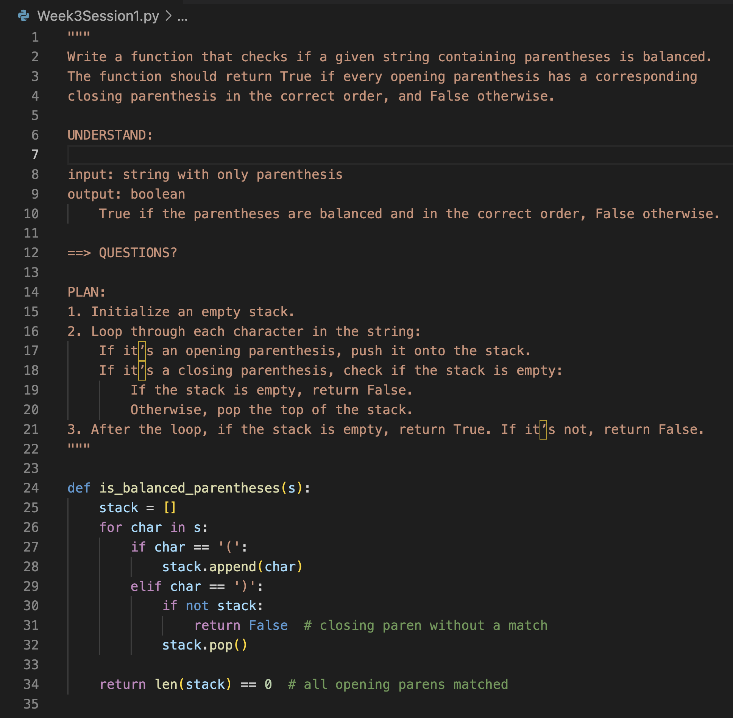
20 minutes
Notes:
🌟 Purpose: To demonstrate the Understand, Plan, and Implement steps of the UMPIRE strategy for solving the problem of checking balanced parentheses. Focus on clearly explaining the problem requirements, designing a solution, and beginning the implementation process.
✅ What should I be doing?
Walk through the Understand, Plan, and Implement steps:
Understand: Break down the problem and clarify the input/output.
Plan: Write out pseudocode for the solution using a stack.
Implement: Start coding the solution and test with one of the provided examples.
Engage students by asking questions and incorporating their feedback during planning and coding.
🎙️ What should I be saying?
Understand:
Let’s start by making sure we fully understand the problem. Our input is a string containing only parentheses, and our output is a boolean: True if the parentheses are balanced and in the correct order, False otherwise.
For example, if the input is "(())", it should return True, because every opening parenthesis has a corresponding closing one. But if the input is "(()", it should return False, because one opening parenthesis is missing its match.
Does anyone have questions about what the problem is asking us to do? [Pause for answers.]
Plan: "Now let’s plan our approach. We’ll use a stack because it’s a perfect tool for managing opening and closing parentheses. Here’s the step-by-step idea:
Initialize an empty stack.
Loop through each character in the string:
If it’s an opening parenthesis, push it onto the stack.
If it’s a closing parenthesis, check if the stack is empty:
If the stack is empty, return False.
Otherwise, pop the top of the stack.
After the loop, if the stack is empty, return True. If it’s not, return False.
This plan helps us ensure that every opening parenthesis has a corresponding closing one and that the order is correct. Does this make sense? What questions do you have about the plan?"
Implement:
Let’s start coding this step by step. I’ll begin by writing the loop to iterate through the string and handle opening parentheses. While I code, let’s think about how we’ll handle the closing parentheses check. [Pause to engage students.]
Does this first part make sense so far? Let’s test it with a basic input like "(())" and see if the stack behaves as we expect.
🙌🏽 How should I engage students?
Ask guiding questions during each step:
"What do you think happens if we don’t check if the stack is empty when we see a closing parenthesis?"
"Why is it important to check the stack after the loop ends?"
Encourage predictions: Before running the code, ask students what they expect the output will be for a given test case.
Normalize mistakes: Introduce a small mistake, such as forgetting to check the stack at the end of the loop, and debug it together.
"Hmm, this isn’t working as expected. Does anyone see what I missed?"

Slide 27
POLL #1
Given two strings S and T, return if they are equal when both are typed into empty text editors. # means a backspace character.
S = "ab#c" → should become "ac"
T = "ad#c" → should also become "ac"
Which data structure is best used to simulate the behavior of typing and deleting characters?
A. Queue
B. Stack
Notes:
🌟 Purpose: To introduce the concept of queues, explain their use cases, and demonstrate their implementation in Python using the deque class.
✅ What should I be doing?
Explain the FIFO (First In, First Out) principle with a relatable example.
Discuss the use cases for queues in practical applications like task scheduling and breadth-first search (BFS).
Provide a brief overview of how Python's deque class is used to implement queues.
🎙️ What should I be saying?
Queues are a data structure that operate on a First In, First Out principle, meaning the first element added is the first one to be removed. Think about a line at a movie theater—the first person in line is the first to get their ticket.
Queues are commonly used in task scheduling, where jobs need to be processed in the order they are received, and in algorithms like breadth-first search, where we explore nodes level by level.
In Python, we use the deque class from the collections module to implement queues because it is optimized for adding and removing elements from both ends efficiently. Let’s look at a simple example in Python.
🙌🏽 How should I engage students?
Ask: "Can anyone think of other scenarios where a queue might be useful, either in programming or in real life?"
Provide a quick Python example: from collections import deque
queue = deque()
queue.append(1) # Enqueue
queue.append(2)
print(queue.popleft()) # Dequeue: Output 1
After showing the code, ask: "What do you think will happen if we print the queue now? Why?"
Encourage questions and discussion about the differences between stacks and queues: "What makes queues different from stacks, and why would we use one over the other?"

Slide 28
Two Pointer Technique
Given two strings S and T, return if they are equal when both are typed into empty text editors. # means a backspace character.
S = "ab#c" → should become "ac"
T = "ad#c" → should also become "ac"
Which data structure is best used to simulate the behavior of typing and deleting characters?
A. Queue
B. Stack
Notes:
🌟 Purpose: To introduce the concept of queues, explain their use cases, and demonstrate their implementation in Python using the deque class.
✅ What should I be doing?
Explain the FIFO (First In, First Out) principle with a relatable example.
Discuss the use cases for queues in practical applications like task scheduling and breadth-first search (BFS).
Provide a brief overview of how Python's deque class is used to implement queues.
🎙️ What should I be saying?
Queues are a data structure that operate on a First In, First Out principle, meaning the first element added is the first one to be removed. Think about a line at a movie theater—the first person in line is the first to get their ticket.
Queues are commonly used in task scheduling, where jobs need to be processed in the order they are received, and in algorithms like breadth-first search, where we explore nodes level by level.
In Python, we use the deque class from the collections module to implement queues because it is optimized for adding and removing elements from both ends efficiently. Let’s look at a simple example in Python.
🙌🏽 How should I engage students?
Ask: "Can anyone think of other scenarios where a queue might be useful, either in programming or in real life?"
Provide a quick Python example: from collections import deque
queue = deque()
queue.append(1) # Enqueue
queue.append(2)
print(queue.popleft()) # Dequeue: Output 1
After showing the code, ask: "What do you think will happen if we print the queue now? Why?"
Encourage questions and discussion about the differences between stacks and queues: "What makes queues different from stacks, and why would we use one over the other?"

Slide 29
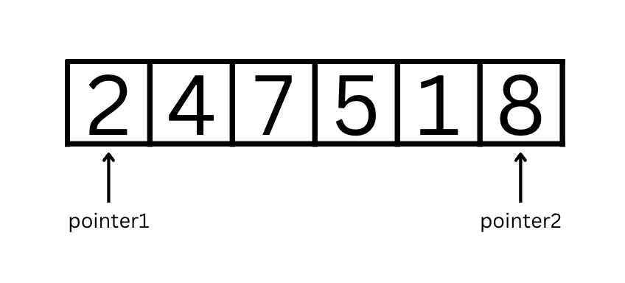
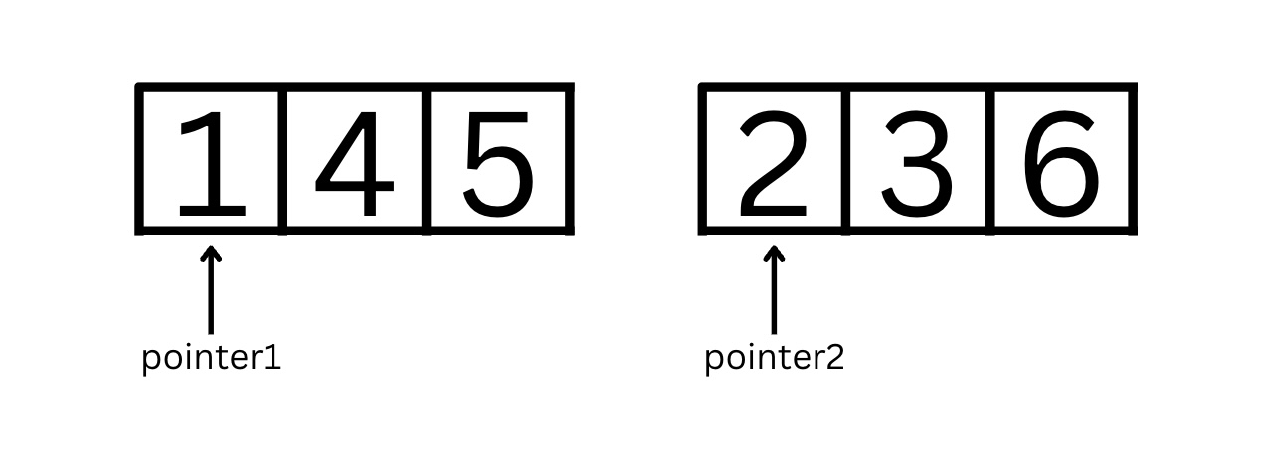
Two Pointer Technique
Initialize two pointer variables to track different indices or places in
String
List
Linked list
and move them based on certain conditions
Opposite direction or same direction
Different starting point and different speed
Notes:
🌟 Purpose: To introduce the concept of queues, explain their use cases, and demonstrate their implementation in Python using the deque class.
✅ What should I be doing?
Explain the FIFO (First In, First Out) principle with a relatable example.
Discuss the use cases for queues in practical applications like task scheduling and breadth-first search (BFS).
Provide a brief overview of how Python's deque class is used to implement queues.
🎙️ What should I be saying?
Queues are a data structure that operate on a First In, First Out principle, meaning the first element added is the first one to be removed. Think about a line at a movie theater—the first person in line is the first to get their ticket.
Queues are commonly used in task scheduling, where jobs need to be processed in the order they are received, and in algorithms like breadth-first search, where we explore nodes level by level.
In Python, we use the deque class from the collections module to implement queues because it is optimized for adding and removing elements from both ends efficiently. Let’s look at a simple example in Python.
🙌🏽 How should I engage students?
Ask: "Can anyone think of other scenarios where a queue might be useful, either in programming or in real life?"
Provide a quick Python example: from collections import deque
queue = deque()
queue.append(1) # Enqueue
queue.append(2)
print(queue.popleft()) # Dequeue: Output 1
After showing the code, ask: "What do you think will happen if we print the queue now? Why?"
Encourage questions and discussion about the differences between stacks and queues: "What makes queues different from stacks, and why would we use one over the other?"

Slide 30
Two Pointer Technique - WHEN
Reducing nested loops
Search for a pair or a triplet
In place operations
Comparing opposite ends of a sequence
Partitioning
Divide and conquer
Notes:
🌟 Purpose: To introduce the concept of queues, explain their use cases, and demonstrate their implementation in Python using the deque class.
✅ What should I be doing?
Explain the FIFO (First In, First Out) principle with a relatable example.
Discuss the use cases for queues in practical applications like task scheduling and breadth-first search (BFS).
Provide a brief overview of how Python's deque class is used to implement queues.
🎙️ What should I be saying?
Queues are a data structure that operate on a First In, First Out principle, meaning the first element added is the first one to be removed. Think about a line at a movie theater—the first person in line is the first to get their ticket.
Queues are commonly used in task scheduling, where jobs need to be processed in the order they are received, and in algorithms like breadth-first search, where we explore nodes level by level.
In Python, we use the deque class from the collections module to implement queues because it is optimized for adding and removing elements from both ends efficiently. Let’s look at a simple example in Python.
🙌🏽 How should I engage students?
Ask: "Can anyone think of other scenarios where a queue might be useful, either in programming or in real life?"
Provide a quick Python example: from collections import deque
queue = deque()
queue.append(1) # Enqueue
queue.append(2)
print(queue.popleft()) # Dequeue: Output 1
After showing the code, ask: "What do you think will happen if we print the queue now? Why?"
Encourage questions and discussion about the differences between stacks and queues: "What makes queues different from stacks, and why would we use one over the other?"

Slide 31

Break Time!
Take 5 mins to step away from the computer. Feel free to turn off your camera and return promptly after 5 mins.
Notes:
🌟 Purpose: Provide a short break to refresh and re-energize.
✅ What should I be doing?
Announce the break and remind students to return on time.
Play the countdown timer video (be sure to share sound).
🎙️ What should I be saying?
Let’s take 5 minutes to step away from the screen. Be sure to return promptly.

Slide 32
Collaborative Problem Solving
60 minutes

Slide 33
Getting Things Started in Breakout Rooms
(Please Watch This Video! In Class!)
👋🏾 Step 1: Say Hello!
Take up to 3 minutes to introduce yourselves and say hello to one another!
Consider choosing an icebreaker from this list to start off the convo!
🚘 Step 2: Assign a Driver
The driver is the person who shares their screen and does the majority of the typing
You can keep one driver for a session, or you can switch problem to problem
👩🏽‍💻 Step 3: Jump Into UPI!
Starting off with the Understand step, each group member should share their input and collaborate on problem solving
Make sure you’re giving every space to contribute!

Slide 34
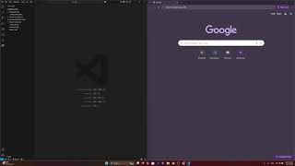
Consider: VS Code Liveshare
VS Code’s Live Share lets multiple people edit a file together.
If interested, watch the video to the right 👉🏽 in your breakout room.
This is optional.
If Live Share lags or takes over 10 minutes to download, skip it and start coding with your group as normal!
Video Link if playback is not working

Slide 35
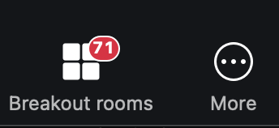
60 minutes
🏃🏽 Navigate to your breakout room.
👋🏽 Introduce yourselves!
🧑🏽‍💻 Work on the problems for your selected unit.

Slide 36
Wrap Up
10 minutes

Slide 37
Notes:
🌟 Purpose: End the session on a positive note.
✅ What should I be doing?
Prompt students to share their reflections in the chat.
🎙️ What should I be saying?
Let’s celebrate your wins. Share one good thing you learned or accomplished today!
🙌🏽 How should I engage students?
Read a few responses aloud and celebrate with enthusiasm.

Slide 38


Early Course Survey!
TIP102 Section 1B
Week 3 Session 1
Notes:
🌟 Purpose: Gather feedback to improve future sessions.
✅ What should I be doing?
Share the survey link and emphasize its importance.
🎙️ What should I be saying?
Your feedback helps us make these sessions even better. Please take a moment to complete the survey.
🙌🏽 How should I engage students?
Thank students for their input and explain how feedback has been used in the past.

Slide 39

Final Reminders
Finish the problem sets for additional practice
Take the weekly HackerRank assessment by Sunday @ midnight
There is class Thursday June 19th - You will have a substitute
Buddy Break Groups (BBG)!
You can sign up with your group using this form
Each person has to fill out an instance of this form asking for the same people to be in their group!
Need a reminder on what BBGs are?
Loom - Introducing the Buddy Breakout Group Feature! 🎉
Notes:
🌟 Purpose: Provide a short break to refresh and re-energize.
✅ What should I be doing?
Announce the break and remind students to return on time.
Play the countdown timer video (be sure to share sound).
🎙️ What should I be saying?
Let’s take 5 minutes to step away from the screen. Be sure to return promptly.

